Slide 1
Processing-in-Flash: Accelerating Training for On-Device Machine Learning
Yoona Kim †, Dusol Lee †, Geonhee Cho †
† Team 3 (SysMo)
Notes:
Good afternoon,
I am Yoona Kim from team 3 ( sysmo)
Our project title is Processing in flash acerating training for on device machine learning
As research interest of us three is mainly focused embedded systems,
especially storage related system architecure,
we wanted to integrate our interest with some of the existing mobile applications that are widely being used or being developed recently.
As nowadays machine learning is everywhere,
we tried to find some of the existing bottleneck from the top application layer to the low level storage devices for those ML related workloads.
For the term project of this course, we have decided to work on suggesting a whole new system design to enforce such ML related applications.

Slide 2
Contents
Motivation & Problem
Related Works
Key Idea & System Overview
Expected Challenges
Evaluation Strategy
Overall Plan
Deliverable
Notes:
Here is the table of the contents of our today’s presentation
We will first deliver problems of the existing solutions and the motivation of our project
Then will explain the related works that have previously done by other researchers
Then the key idea and the system overview of our system and some expected challenges we will be facing in developing our new system design.
Then the plan of our evaluation strategy.
Then the overall plan the the final deliverables

Slide 3
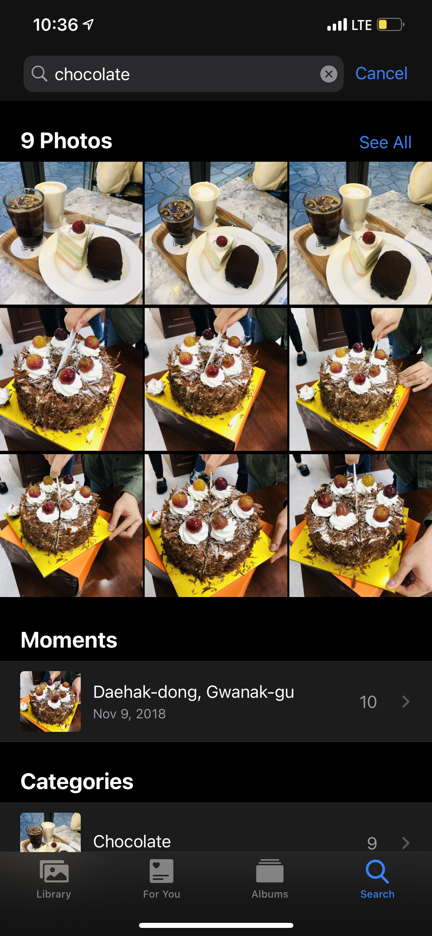
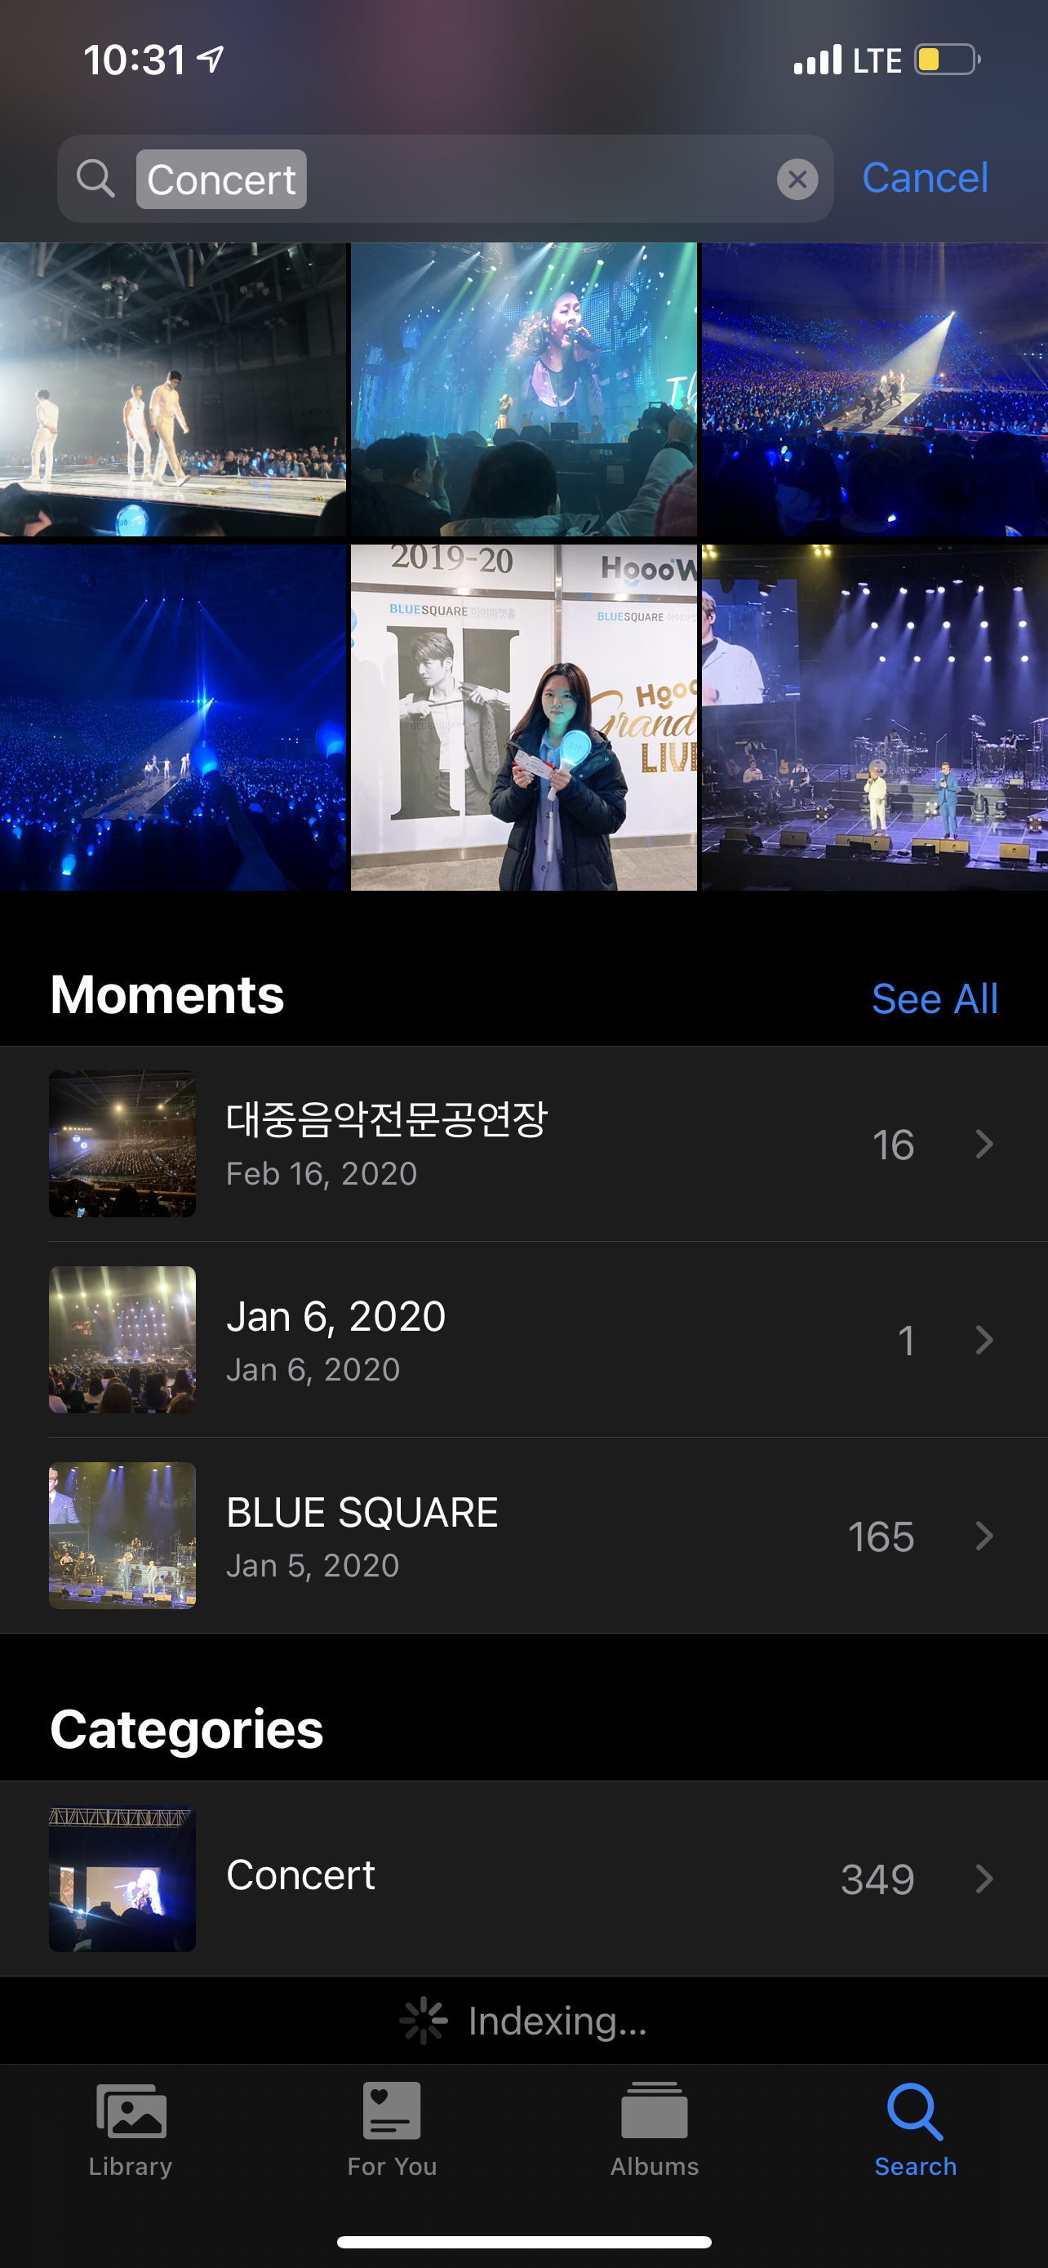
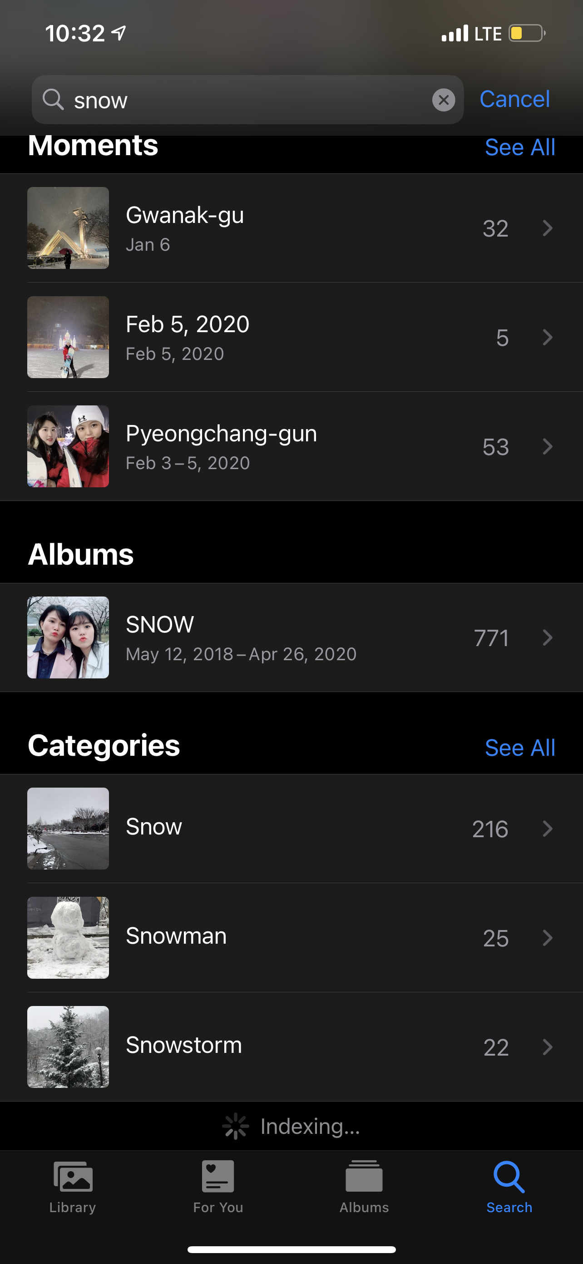


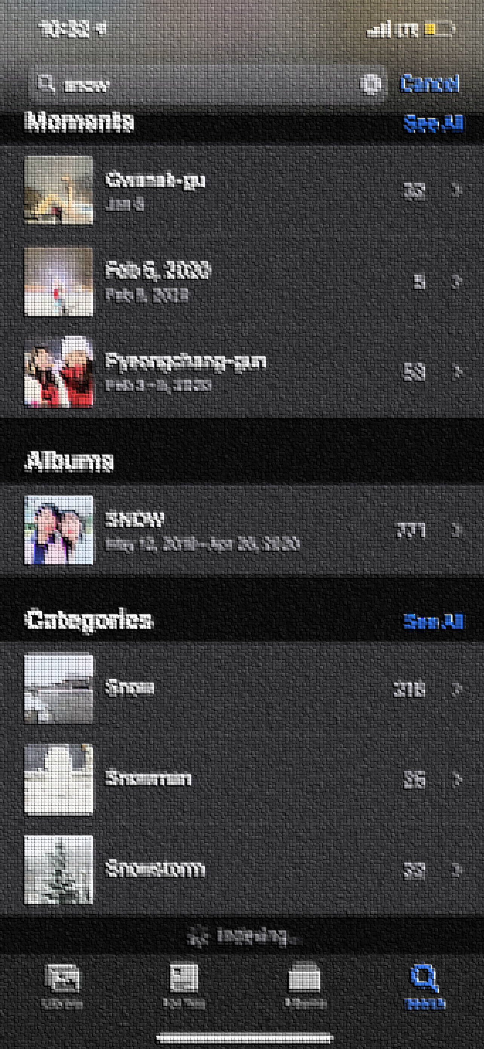

We Expect User-Definable Machine Learning Services !
What if a user wants to add a new category... ?
The system needs to read the whole data
to re-train in order to add a new category
Notes:
So for those of you who are using Iphones,
If you open your gallery you can find that search butoon with that magnifier icon on the bottom right of the application.
Not sure if android phones also have the same functions applied.
Users of this app can search with subjects of their interests such as “chocolate”, concert, snow as the examples shown,
Then the app will show you the corresponding photos on your phone for the search result.
I find this function very useful as I have about 34000 pictures on my phone.
And whenever I want to find specific subject related photos such as strawberry cakes, or some conert pictures
I don’t have to read the whole 34000 pictures by myself.
However, what if I want to find a new group of photos that are not catergoried yet??
For example, I searched 칼국수 on my phone, even if I also have a lot of 칼국수 photos on my phone, it says no results.
In order to add a new category, the system needs to read whole photos that are stored on the storage devices then collect features of the photos for retraining.
Nowadays, the average size of each photo is roughly 3-4mb,
So in my case, the system needs to read 4mb sizes of 34000 pictures in order to add a new category.
This sounds like there will be a lot of read operations and to load such huge amount of data might suffer from the bandwidth bottleneck of the existing system.
전체 데이터를 다 읽어야 하냐?-> 어느정도까지 재학습할지에 따라 그럴 수도 있다.

Slide 4








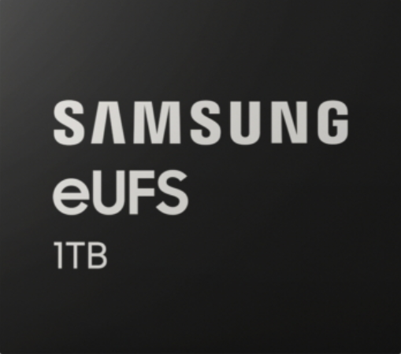
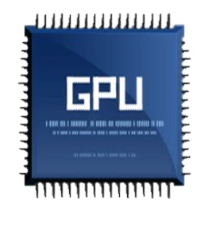
Could It be Deployed w/o Any Problems ?
Training on user device ?
On-device training takes too long !
Offloading training to server ?
User wants to keep its data private !
By solving the bottleneck of on-device,
We don’t need to get help from server computing.
Mobile Device
Cloud Service Providers
DRAM
Data Path Bottleneck !
Privacy Issues !
We want your data !
Storage
Notes:
So, for such cases, there are two different ways for retraining.
First one is training on your own edge device,
However, even if vendors of mobile devices nowadays deploy better performance processing units and bigger sizes of drams on mobile devices.
The links between each unit is still low in bandwidth.
So for CPU to load whole lot of data to DRAM from a storage device and to locate to GPU for processing might take forever.
The second way to re train the model is to send your data to cloud servers via network and let the cloud servers do the training on their high performance devices.
This might sound reasonable, however,
Servers want to keep your data as data are one of the expensive resources theses days,
But users do not want such vendors to keep their data for privacy issues.
So our team wants to suggest a new system design to overcome such data path bottleneck in a way of not expericiing such privacy issues.
Interface Bottleneck
Memory Capacity Wall

Slide 5
Related Works: How to Solve Data Path Bottleneck ?
Mobile Environments
On-Device Machine Learning
Server Environments
Processing-in-Storage
Notes:
Here are some related works regarding on device machine learning methods and
Some of the optimized ways for such training on server computers.

Slide 6





On-Device Machine Learning
Pre-trained model
DRAM
Model training
for user own dataset
...
...
On-device data
Large Data Set
Notes:
On device ML is basically done as you can imagine.
The pretrained model is loaded on user’s own edge device,
Then the model is trained with user’s own device stored on the storage device.
The stored data is loaded to DRAM by CPU and then transferred to GPU or CPU for processing.
As I have mentioned, the bus links between such units are still in low bw, the data movement bottleneck or some popular memory capacity wall problems might exisit.

Slide 7



Processing-in-Storage (PiS)
Computation overhead reduction
DRAM
Offload computation to storage
Alleviate data movement bottleneck
Only move pre-processed data
(Downsized data)
SSD with Accelerator
Computation Resource
DRAM
Accel.
SSD Ctrl.
Notes:
In order to resolve such data movement bottleneck in the traditional server architecture, there were some techniques introduced.
Maybe some of you might have heard about Processing in storage, PiS
Which offloads computation to storage devices by exploiting the compute processes on the strage devices.
By doing so the computation overhead of CPU can be reduced, and the data movement bottleneck can be alleviated.

Slide 8
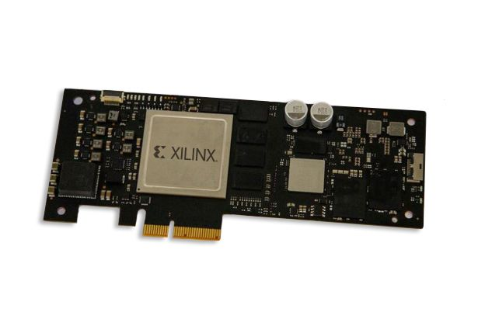
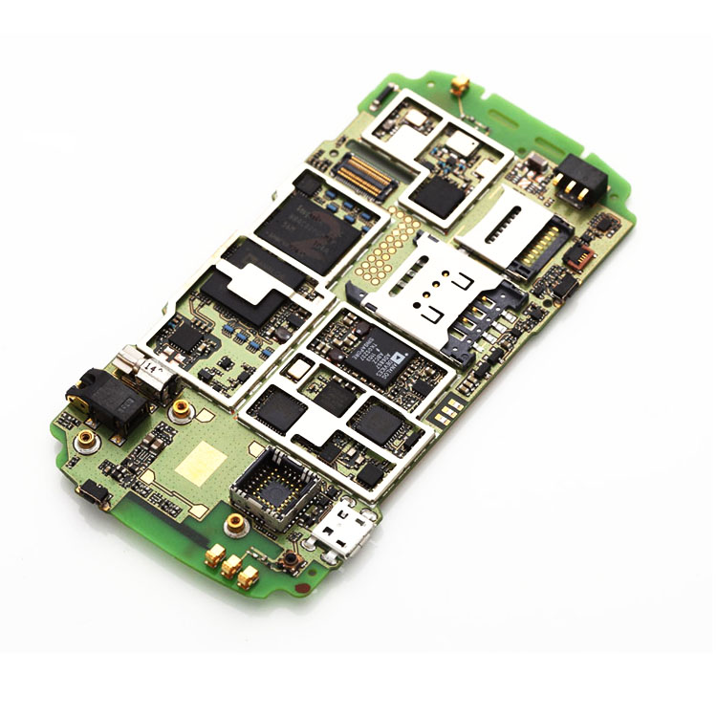
Can We Use On-Device Processing-in-Storage ?
Server-Class NAND Flash
vs
Mobile-Class NAND Flash
Enough Space for Large Accelerator
No Space for Large Accelerator
Large Memory on SSD
Small Memory on Embedded Flash Chip
Notes:
such pis system was ok for server class nand flash devices as they have enough space for large sized accelerators, and also large sized memory on SSDs/
However, for such mobile-class nand flash chis, there is not enough space to place accelerators and memory size is very small on such embedded flash chips.

Slide 9
Key Idea & System Overview
Processing-in-Flash (PiF)
Same Idea w/ Processing-in-Storage !
Can be used for mobile embedded flash chip !
Accelerator is hide on Flash Chip !
Accel.
Notes:
The key idea of the system is processing in flash which is similar idea with processing in storage.
PiF can be used for mobile embedded flash chips and the accelerator can be hidden on flash chips.

Slide 10


Cell-over-X (CoX)
Current Cell-over-Peri (CoP) Structure
Proposing Cell-over-X (CoX) Structure
3D NAND Chip
3D NAND Chip
Peri
Peri
Free Space
Utilize Free Space
Xcore
Place accelerator for on-chip processing
Notes:
This is some what details of our research interest,
So to easily explain,
Recent NAND chips are developed in the 3D architecture,
By exploiting the 3D architecture, the formation of the NAND Flash chip ended up having some free space on the bottom.
So there has been researches and findings exploiting that free space.
We are suggesting to place accelerators on the butoom of that free space.
For the specific specs for the Processing unit to place on the free space of the chip,
we are currently working on figuring out the configuration parameters that are feasible for such chips.
칩 내부 가속을 위한 가속 모듈 Xcore 배치

Slide 11
Expected Challenges
Physical Formulation Difficulty
It is difficult to implement real NAND Flash chip
It is difficult to integrate the whole system on real device
Notes:
Here are some expected challenges of our term project.
As the idea of placing accelerators on such 3D nand chip is just a new suggesting idea,
The physical formulation is quite difficulty to frankly saying it is impossible for us to form the real chip to evaluate the performance of our suggesting idea.
However, we can figure out the detailed configuration parameters regrarding

Slide 12
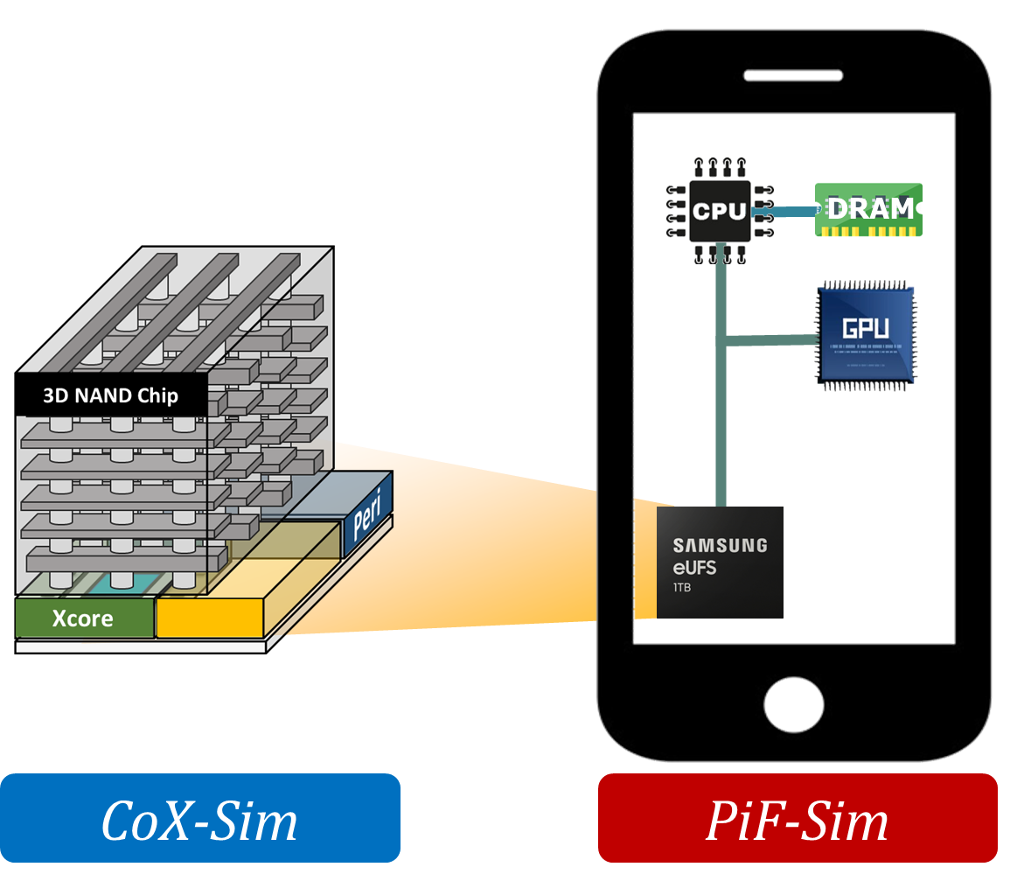
Evaluation Strategy
Metric
Scalability
Performance
Power Consumption
Benchmarks
TBD
Design Space Exploration
System Evaluation
Notes:
For evaluation, we will focus on scalability, perforamc and power consumption aspects,
In order to do so, we will explolit CoX (chiop on X simulator we are currently builindg for design space exploration and the PiF simulator for system evaluation.

Slide 13
Overall Project Plan
#Iter. | Objective | Duration | Misc.
1 | Ideation & Proposal validation Literature Review, Proposal Feedback | 03/16 – 03/30 | 03/23 proposal (week 4)
2 | Build project environment & Design system Build Env. for project, Design Arch. and techniques. | 03/31 - 04/14
3 | Implement Techniques & System Implement techniques and Integrate all into system | 04/15 – 05/25 | 05/04 demo (week 10)
4 | Evaluation Evaluate system with training Algorithms | 05/26 – 06/08 | 06/08 final (week 15)

Slide 14

Deliverable
Midterm Deliverable | Final Deliverable
Reasoning over project topic | Technical Report regarding evaluations
Design of CoX Flash chip (including tool code for design space exploration) | Simulator (or Emulator) code for Proof-of-Concept
Success Criteria
Performance(Processing-in-Flash) $≥$ Performance (Traditional On-Device Processing)

Slide 15
Thank You !
Any questions or feedback are welcome.

